Slide 1
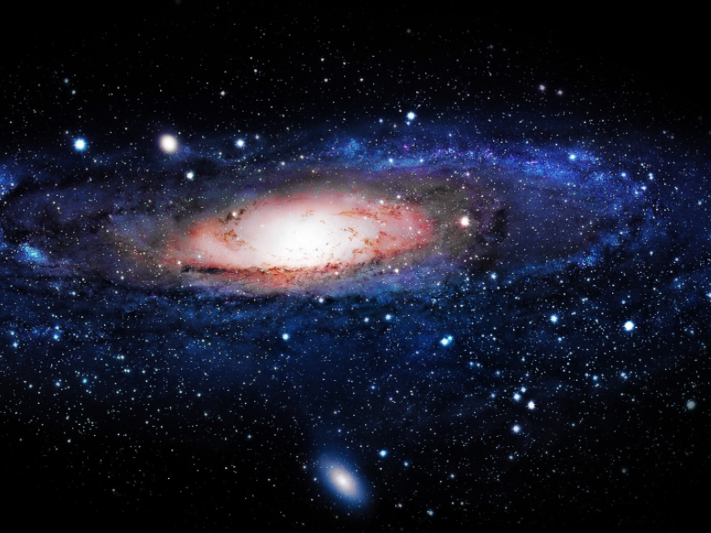

ASTROPHYSICS + DATA SCIENCE

Slide 2


WHAT’S NEW?
ASTROPHYSICS - A branch of Space Science that applies Physics, Chemistry and Statistics to explain the birth, life and death of stars, planets, galaxies, nebulae, etc
RESEARCH: SKA (Square Kilometre Array) Telescope
Project to build the world’s biggest and most sensitive multi radio telescope
The project is to commence in 2018 and is expected to be completed by 2030
Total signal-collecting area of all the dishes, about 3000 of them, will add up to 1 km² (11,000,000 sq ft)
Estimated project cost is €2 billion
The global Headquarters of the SKA is Jodrell Bank Observatory
Telescopes to be located in South Africa and Australia
3‚000 petabytes of data to be generated yearly (about 160 terabytes per second)
World’s largest public data project
ULTIMATE CHALLENGE – DATA PROCESSING

Slide 3
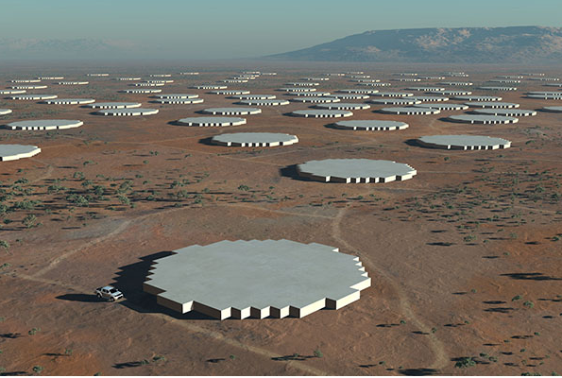
BENEFITS OF THE SKA
Will lead to development of the most powerful supercomputing facility in the world (equivalent to around one hundred million times the computing power of today’s PCs and one trillion times that which landed men on the Moon).
Support Climate modelling
Increase in knowledge about the Universe
Lead to advances in Data Science and Storage
Emerging sciences such as nanotechnology
Development of innovative renewable energy solutions

Slide 4
Countries involved in the SKA Project
Australia: Department of Industry and Science
Canada: National Research Council
China: Ministry of Science and Technology of the PRC
India: National Centre for Radio Astrophysics
Italy: National Institute for Astrophysics
New Zealand: Ministry of Economic Development
South Africa: National Research Foundation
Sweden: Onsala Space Observatory
The Netherlands: Netherlands Organisation for Scientific Research
United Kingdom: Science and Technology Facilities Council

Slide 5
WHAT ELSE IS NEW?
BREAKTHROUGH: Within 180 million years of the Big Bang, stars were born
Experiment to Detect the Global EoR (Epoch of Reionization) Signature (EDGES) Project
Project funded by the United States National Science Foundation (NSF)
Discovery announced on February 28, 2018
Developed statistical techniques for refining signal data
Project team were drawn from Arizona State University (ASU), the Massachusetts Institute of Technology (MIT) and the University of Colorado at Boulder
Telescopes cannot see far enough to directly image ancient stars, thus Data from radio waves arriving from space used for analysis and prediction to detect first stars in universe

Slide 6
DATA SCIENCE
…Helping Man Discover The Unknown

